Slide 1


Week- 10 Agile Roles and Ceremonies Dr. Bhuvan UNHELKAR IT Faculty, College Of Business; Office: C225; bunhelkar@sar.usf.edu; 941-359-4654

Slide 2

Agenda
Three elements of Agile/Scrum:
Roles, Ceremonies, Artifact
We have studied some but here we formalize them
Summary & Consolidation

Slide 3

Sub-Module Agile Project Elements
Roles, Ceremonies, Artifacts
© MethodScience; Material Designed and Presented by Dr. B. Unhelkar; drawn from The Art of Agile Practice

Slide 4
Figure 5.13: Three Categories of Agile Elements
Agile Coach
Product Owner
(SMEs)
Team Members
(Avatars)
Users
…
Roles
Backlogs
Stories
Charts
Priorities
Estimates
…
Artefacts
Standups
Reviews
Showcases
Iterations
Sprints
Prioritize
…
Agile in
Development
Ceremonies

Slide 5
Sub-Module In the Context of Agile Process
Positioning Roles, Ceremonies, Artifacts in an Agile Process
© MethodScience; Material Designed and Presented by Dr. B. Unhelkar; drawn from The Art of Agile Practice

Slide 6
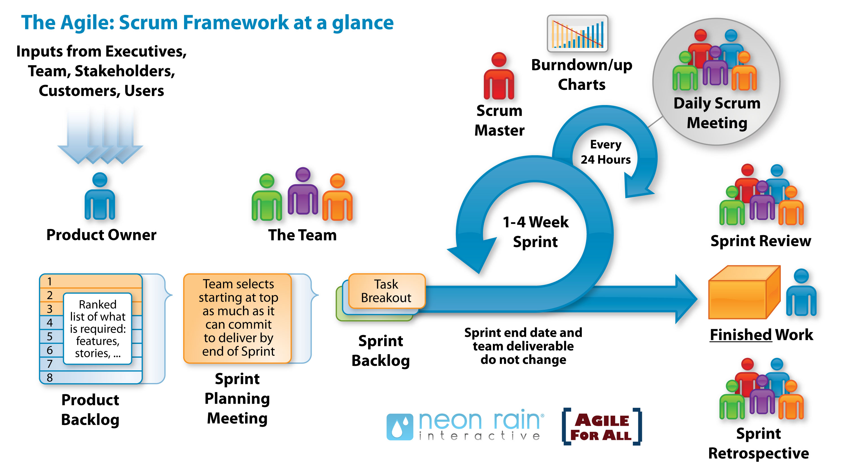

Slide 7
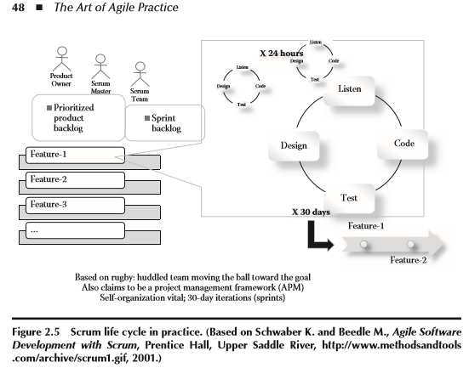
A typical Scrum Life Cycle (repeated from last week)

Slide 8
Key Roles in Agile Scrum (We will use them for Agile Overall – “Pigs” Committed; “Chicken” Involved)
Product Owner
Owns the Product as it gets developed; Hence is in charge of Product backlog
Scrum Master (Agile Coach)
(May be understood as a Team Lead; although not exactly)
Defines sprints/releases (and Iterations – together with the Iteration Manager, in large Projects)
Facilitates, Leads, Fixes and is a Gatekeeper
Has two major Responsibilities
Protecting the team from outside disturbances
Clearing the way by solving problems
Scrum Team
Team members made up of Developers/Testers in Software Projects
Together they Estimate Time and Effort for Backlog items
Recommended Size is = 7 ± 2
Notes:
While these are Scrum roles, they can be used in other non-software development projects as well.

Slide 9
Additional Role - Stakeholders (that support the Agile project)
Stakeholders
Project Sponsor – who is paying for the Project
Customer – if it is an External project
Vendor – who is providing input in the project or has a stake in the project
Senior Managers / Executive – who also have an interest in the project
End User representative
Stakeholders have a say in the Product Backlog

Slide 10
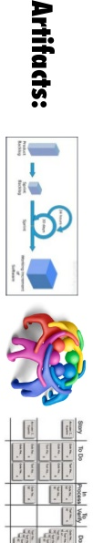
Agile Artifacts
User Stories
Basic Functional Requirement
Product Backlog
Total list of product features
Wish list
Sprint Backlogs
Subset of product backlog items
Work remaining on each task is tracked
Burn down Charts
Depicts the DONE and outstanding Stories (functionality) in the Project

Slide 11
Sub-Module Roles – Separating the Two!!
Project Roles versus User Roles
© MethodScience; Material Designed and Presented by Dr. B. Unhelkar; drawn from The Art of Agile Practice

Slide 12
Project Roles versus User Roles
Example (Banking Domain):
Project Role = Product Owner
User (Actor) Role = Customer (having a Checking or Savings account)
Project Roles are internal to the Project
Project Roles are creating the solution; they do NOT appear in the Solution
User Roles are Users (Actors)
They Use the Solution; they may not be in the project yet the project is to produce a solution for their benefit

Slide 13
Sub-Module Ceremonies / Events
Agile / Scrum
© MethodScience; Material Designed and Presented by Dr. B. Unhelkar

Slide 14
Scrum Events
Page 9 onwards in Scrum Guide
The Sprint
Sprint Planning
Daily Scrum
Sprint Review
Sprint Retrospective

Slide 15
Sub-Module Challenges in Agile Projects
Chapter 3
© MethodScience; Material Designed and Presented by Dr. B. Unhelkar; drawn from The Art of Agile Practice

Slide 16
Chapter 3
We now shift focus to Agile Project Challenges - for this, you need to go back to Chapter 3, Page 74 to 78. You should form an opinion as to whether you agree or disagree with some of these challenges.
Now move to Page 84 where the section "Project Management and Agile" starts. Read that entire section which finshes on Page 86 with the Sidebar.
Table 3.1 is helpful in not only identifying the Challenges but also hinting at NFRs

Slide 17
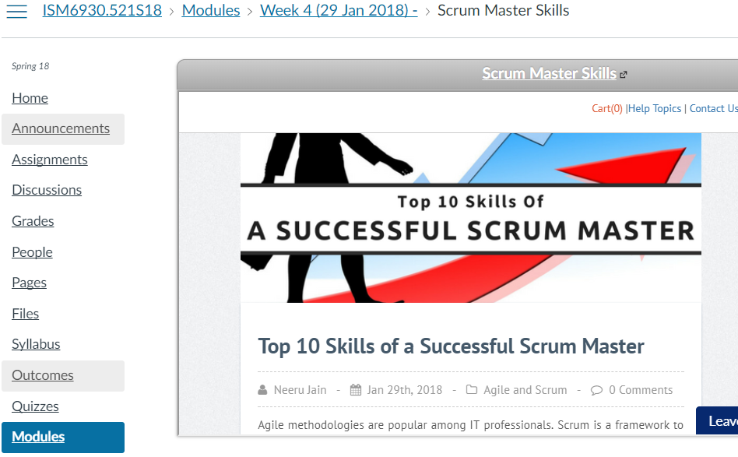
Leadership is a vital Key to handling these challenges

Slide 18
Sub-Module Agile Teams
Cross-Functional; Co-Located;
© MethodScience; Material drawn from The Art of Agile Practice (B. Unhelkar)

Slide 19


Slide 20
Conclusions & Future Directions
We discussed…??
Do you see what we see?

